Slide 1




UrbanIQ: Revolutionizing Smart Cities
A COMPREHENSIVE SOLUTION FOR TRAFFIC MANAGEMENT, ENERGY EFFICIENCY, PUBLIC SAFETY, AND URBAN PLANNING
Presented by: Nano Nimbles

Slide 2


About Us
Welcome to Nano Nimbles, where innovation meets determination! We are a dynamic team of aspiring engineers from the Institute of Engineering and Technology (IET Lucknow), driven by our passion for technological advancement and a relentless pursuit of excellence.

Slide 3

INTRODUCTION
Urban Challenges
Brief overview of the challenges faced by modern cities: traffic congestion, energy wastage, public safety concerns, and inefficient urban planning.
The necessity for innovative solutions to promote sustainability, efficiency, and safety.

Slide 4
INTRODUCTION
UrbanIQ
UrbanIQ as an integrated smart city platform.
Utilizing AI, IoT, big data analytics, and blockchain technology.
Aimed at addressing the core challenges of urbanization.

Slide 5




Traffic Management Solutions
Smart Traffic Signal Systems:
AI-powered signals that adapt to traffic conditions in real-time.
Real-Time Navigation Applications:
Offering optimal routes based on current traffic data and incidents.
Public Transportation Initiatives:
Encouraging the use of efficient and eco-friendly transport options.

Slide 6



Energy Efficiency Innovations
Smart Grid Technologies:
Enhancing energy distribution and reducing wastage.
Energy Consumption Monitoring:
Tools for buildings and street lighting to optimize energy use.
Renewable Energy Initiatives:
Promoting solar panels and wind turbines within urban infrastructures.

Slide 7



Enhancing Public Safety
Predictive Policing Technologies:
Using data analytics to predict and prevent crime hotspots.
Real-Time Crime Mapping:
Mobile applications for citizens and authorities to view and report incidents.
Rapid Disaster Response Systems:
IoT and AI for quicker, more efficient emergency responses.

Slide 8



Sustainable Urban Planning Tools
Data-Driven Decision-Making:
Platforms for urban planners to access comprehensive data for informed decisions.
Community Engagement Platforms:
Encouraging citizen participation in urban development processes.
Resource Allocation Optimization:
Solutions for maximizing the use of urban spaces and resources.

Slide 9


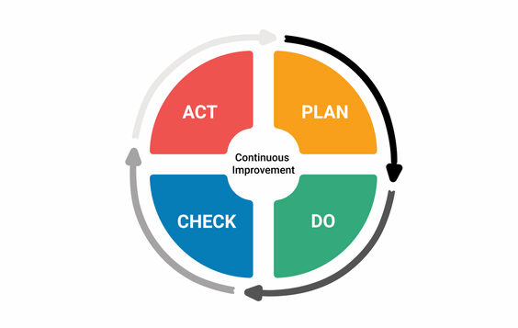


Implementation Strategy
Phased rollout of UrbanIQ components.
Collaboration with city authorities, tech companies, and community organizations.
Pilot projects in selected neighborhoods before city-wide adoption.

Slide 10

Impact Assessment
Expected reductions in traffic congestion, energy consumption, and crime rates.
Enhanced public participation in urban planning.
Long-term sustainability and resilience of urban areas.

Slide 11
Conclusion and Call to Action
The urgency for smart city solutions in the face of rapid urbanization.
UrbanIQ's role in creating more livable, efficient, and safe cities.
Invitation for stakeholders to join the UrbanIQ initiative.

Slide 12

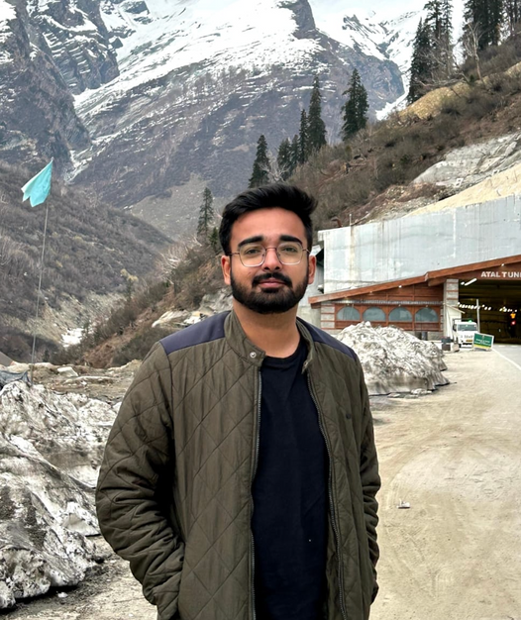
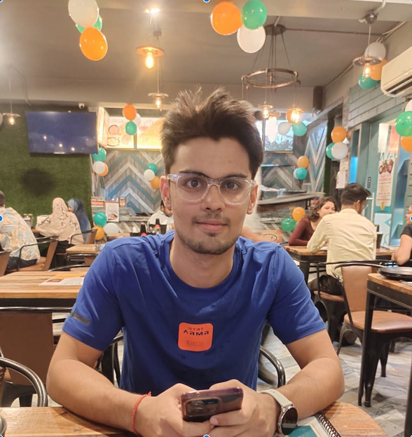
Our team
Krishna Mohan Pandey
Arnav Tiwari
Harsh Dwivedi

Slide 13
THANK YOU

